Slide 1
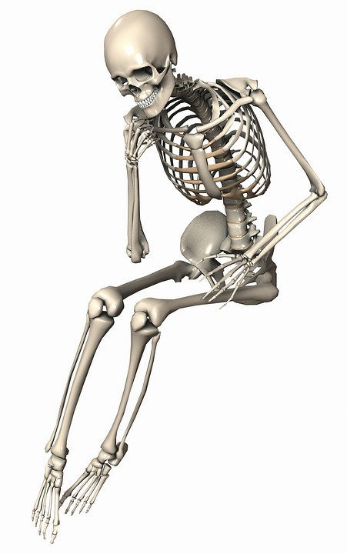
Death, Data and you
An exploration into what kills us and how interesting we think those things are

Slide 2
Terrorism

Slide 3
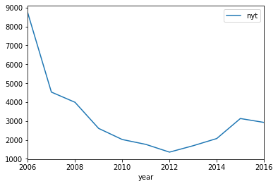
Number of New York Times articles about Terrorism per year
Source: New York Times

Slide 4
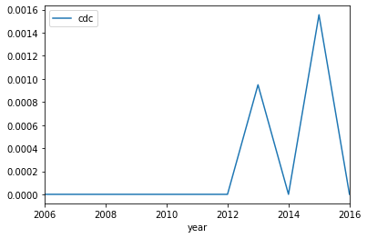
Terrorism deaths per 100,000
<10 deaths
Source: CDC

Slide 5


Slide 6
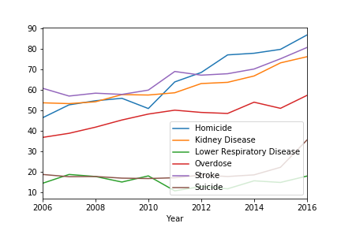
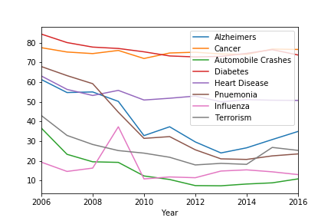
Google Search Trends
Google Search Trends: Growth
Google searches for cause of deaths have shifted from 2006 - 2016
Suicide (+90%), Homicide (+87%), Overdose (+56%), and Kidney Disease (+42) show the largest search growth
Auto Crashes (-71%), Pnuemonia (-65%), Alzheimer (-43%), and Terrorism (-41%) show the largest decreases
Search Popularity
Google Search Trends: Declines
Search Popularity
Source: Google Trends Yearly 2006-2016

Slide 7
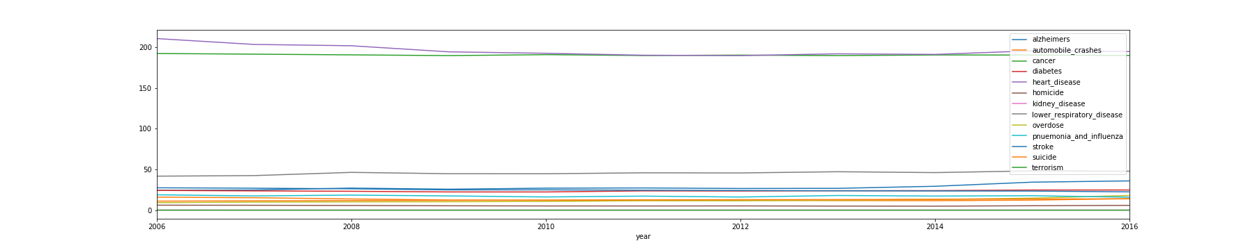
Causes of Death (CDC) over Time

Slide 8

Overdose Deaths and Automobile Accidents

Slide 9
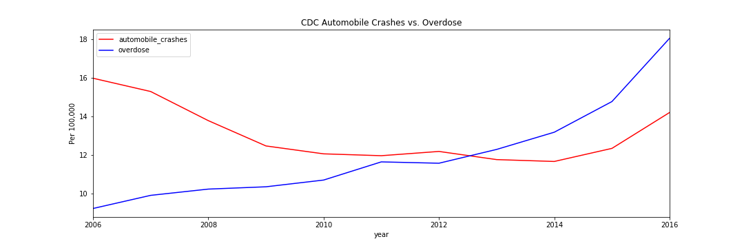
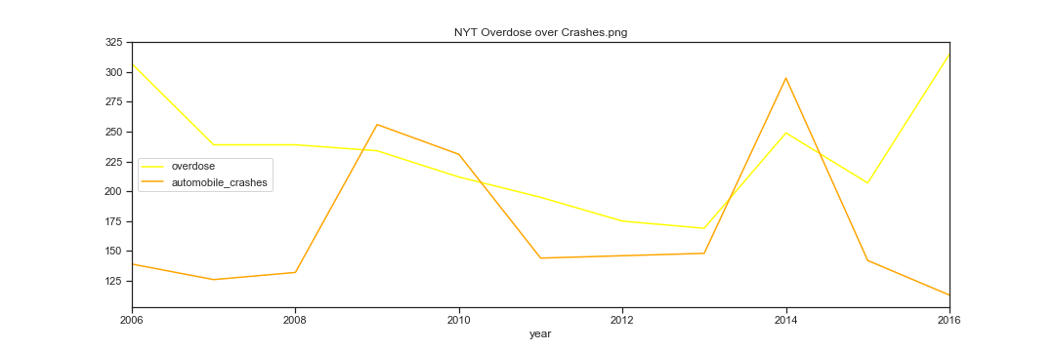

Slide 10
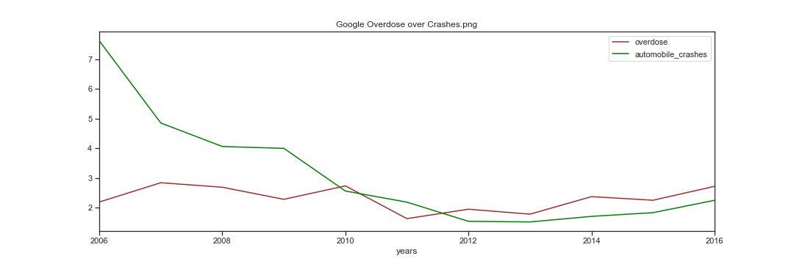

Slide 11

Heart Disease
Diabetes

Slide 12
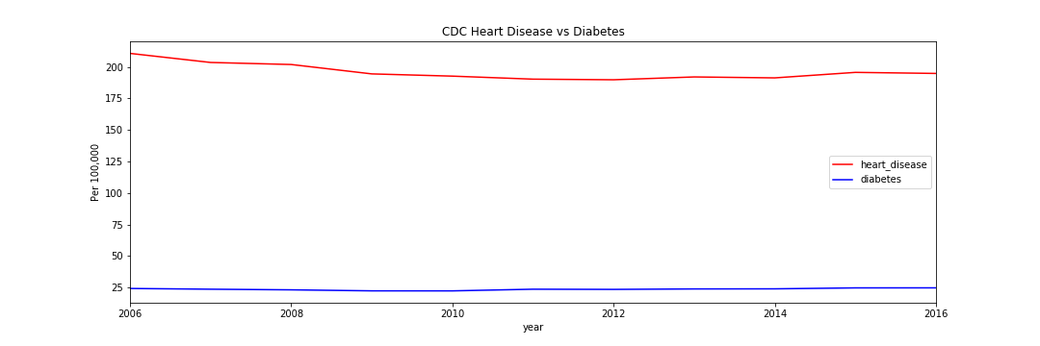

Slide 13
